Slide 1
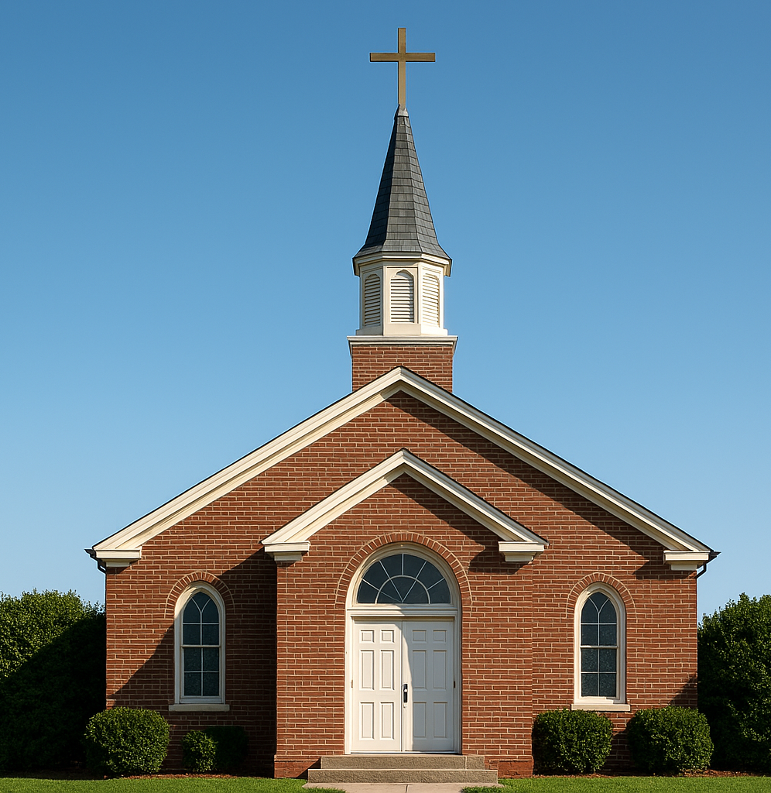
From Organic to Organized: How Leadership and Operations Must Evolve as Churches Grow
Notes:
--- This slide references information from the following file: https://redeemercitytocity.com/articles-stories/leadership-and-church-size-dynamics-how-strategy-changes-with-growth Keller’s Size Categories

Slide 2


Slide 3
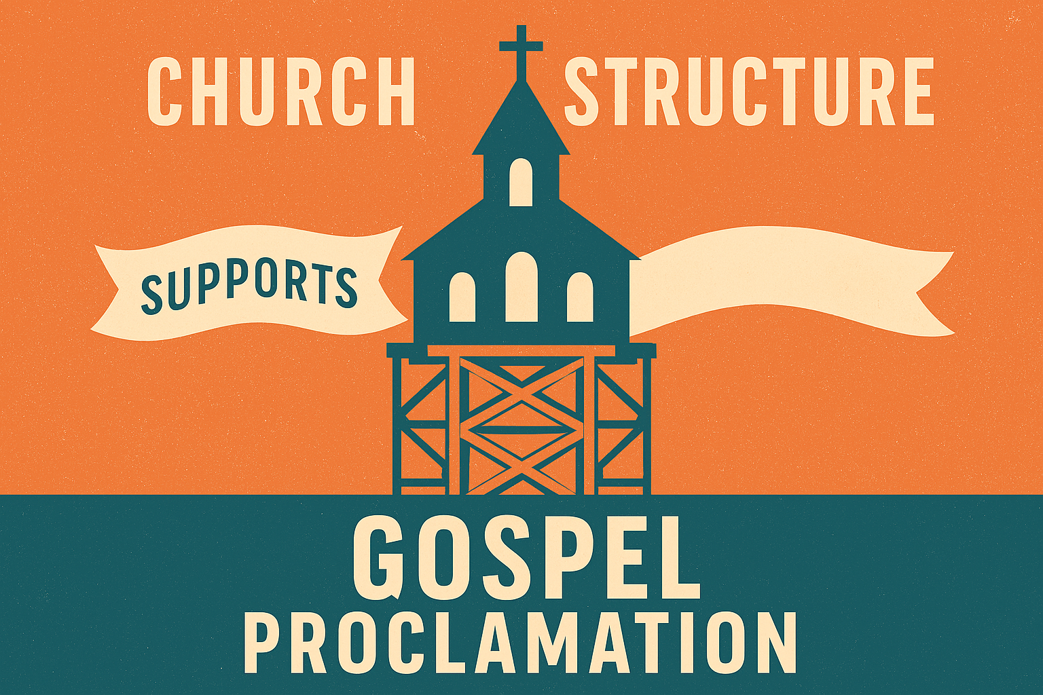

Slide 4
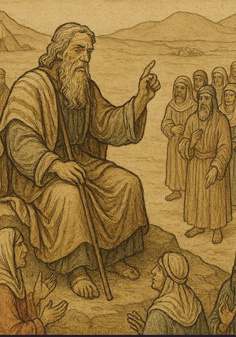

Exodus 18:13-26 ~ Moses Appoints Judges
Evident Need for Change:
Moses was burning out
Long delays for God’s people receiving care
Adjustment:
Established a tiered structure
Trained/appointed local judges
Ministry Blessings
Sustainable workload
God’s people received timely care.

Slide 5
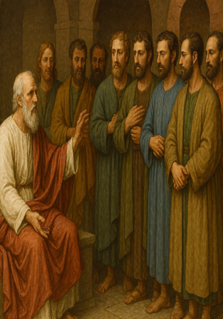
Acts 6:1-7 ~ The Apostles Increase Staffing
Evident Need for Change:
Growing Congregation – Apostles overwhelmed
Mercy ministry foundering
Adjustment:
Called qualified men to administrate mercy ministry.
Narrowed the focus of Apostles work to carry out duties for which they were specifically called/trained
Ministry Blessings
Apostolic priority of Gospel proclamation and prayer upheld
Physical needs of God’s people faithfully met

Slide 6
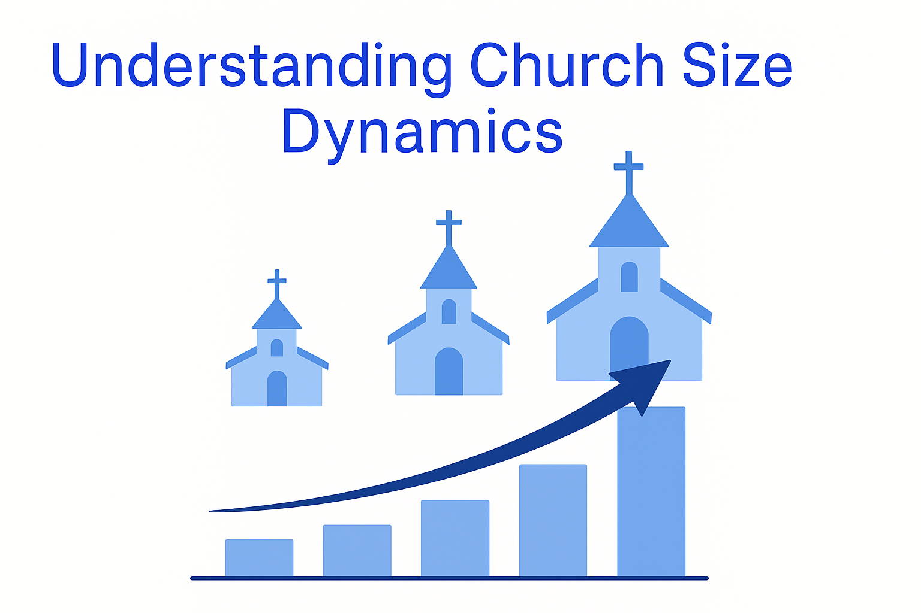
Notes:
--- This slide references information from the following file: https://redeemercitytocity.com/articles-stories/leadership-and-church-size-dynamics-how-strategy-changes-with-growth,https://reformedperspectives.org/articles/tim_keller/tim_keller.Leadership.html Impact of Size on Church Functionality

Slide 7

Impact of Size on Church Functionality
Qualitative Shift with Size
Church size causes a qualitative change in operations, impacting culture, leadership, and decision-making.
Small Church Characteristics
Smaller churches have close relationships, informal communication, and direct pastoral care.
Large Church Requirements
Larger churches need structured systems, delegation, specialized staff, and robust administration.
Adapting Leadership Strategies
Effective ministry requires adapting leadership and practices to fit the church's size culture.
Notes:
--- This slide references information from the following file: https://redeemercitytocity.com/articles-stories/leadership-and-church-size-dynamics-how-strategy-changes-with-growth,https://reformedperspectives.org/articles/tim_keller/tim_keller.Leadership.html Church size significantly influences its culture, decision-making processes, and leadership requirements. Tim Keller emphasizes that size is not merely a numerical difference but a qualitative shift in how a church operates. For instance, a congregation of 100 functions vastly differently from one of 1,000, often more so than denominational differences. Smaller churches typically exhibit close-knit relationships, informal communication, and direct pastoral care, while larger churches necessitate structured systems, delegation, and specialized staff roles. Keller introduces the concept of 'size culture,' which shapes expectations and behaviors within the congregation. Members accustomed to small church dynamics may struggle when their church grows, expecting personal access to the pastor or informal governance, which becomes impractical in larger settings. This misunderstanding often leads to leadership challenges and dissatisfaction. Recognizing these dynamics is crucial for pastors and leaders to adapt strategies that align with their church’s size. Larger churches, for example, require robust administrative frameworks, multiple ministries, and clear communication channels to maintain cohesion. Conversely, smaller churches thrive on relational intimacy and flexibility. Both Keller and McIntosh argue that there is no ideal size; each category offers unique opportunities and challenges. Leaders must avoid imposing practices suited for one size onto another, as doing so can hinder growth and create organizational dysfunction. Understanding these principles enables churches to embrace their current size culture while preparing for transitions, ensuring effective ministry and healthy congregational life.

Slide 8
Tim Keller’s Size Categories
Size Category | Attendance | Key Characteristics
House Church | Up to 40 | Highly relational, informal leadership, direct pastoral care
Small Church | 40–200 | Relational focus, emerging structures, limited staff
Medium Church | 200–400 | Programmatic approach, administrative oversight, specialized roles
Large Church | 400–800 | Formal governance, multiple ministries, strategic planning
Very Large Church | 800+ | Complex organization, professional support staff, extensive programming
Notes:
--- This slide references information from the following file: https://redeemercitytocity.com/articles-stories/leadership-and-church-size-dynamics-how-strategy-changes-with-growth Tim Keller delineates five primary church size categories: House Churches (up to 40 attendees), Small Churches (40–200), Medium Churches (200–400), Large Churches (400–800), and Very Large Churches (over 800). Each category represents a distinct organizational reality rather than a scaled version of the previous size. House churches prioritize intimacy and direct pastoral involvement, often functioning like extended families. Small churches maintain relational closeness but begin introducing basic structures for ministry coordination. Medium churches experience a shift toward programmatic approaches, requiring administrative oversight and specialized roles. Large churches necessitate formal governance, multiple staff teams, and strategic planning to manage complexity. Very large churches operate almost like small organizations, with extensive programming, professional staff, and sophisticated communication systems. Keller stresses that leadership skills must evolve across these categories; what works in a small church—such as informal decision-making—becomes ineffective in larger contexts. For example, pastoral care in a very large church relies heavily on lay leaders and small groups rather than direct pastoral contact. These distinctions underscore the importance of contextual leadership, where strategies align with size-specific needs. Failure to recognize these differences often results in organizational strain, unmet expectations, and leadership burnout. By understanding these categories, leaders can anticipate challenges and leverage opportunities unique to each size, fostering sustainable growth and congregational health.

Slide 9
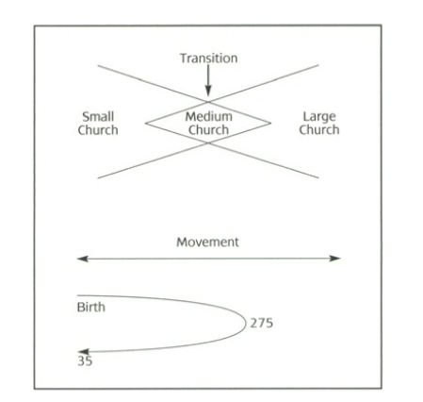

Slide 10
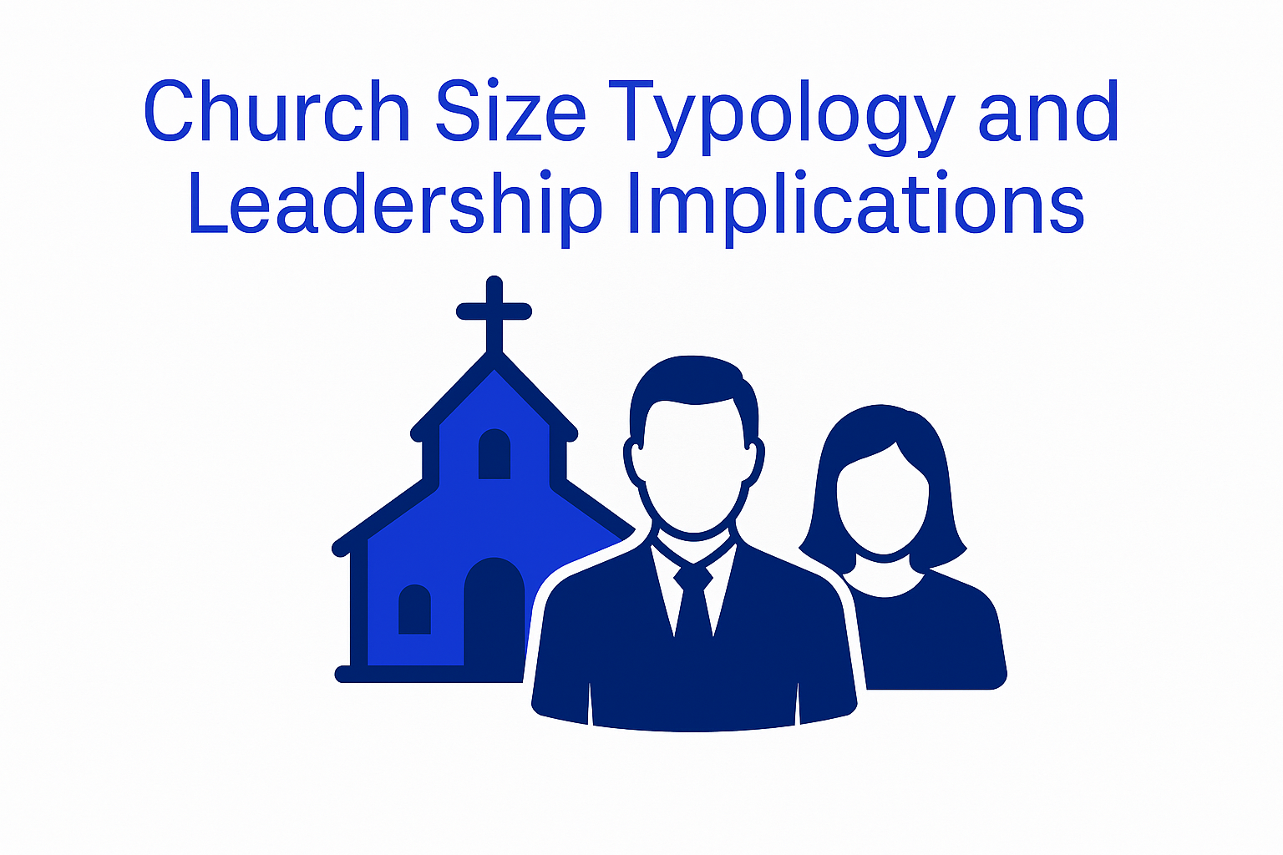
Notes:
--- This slide references information from the following file: https://lifeandleadership.com/book-summaries/mcintosh-one-size-doesnt-fit-all/,https://storage2.snappages.site/GFJPTG/assets/files/Book-Summary-One-Size-Doesn’t-Fit-All--55.pdf Typology of Church Sizes

Slide 11
Typology of Church Sizes
Factor | Small (15–200) | Medium (201–400) | Large (401+)
Orientation | Relational | Programmatic | Organizational
Structure | Single-cell | Stretched-cell | Multiple-cell
Pastor Role | “Family Member” | Administrator | Leader
Decision-making | Congregation-driven | Committee-driven | Leader-driven
Dominant Attribute | Relationships | Programs | Proclamation
Notes:
--- This slide references information from the following file: https://lifeandleadership.com/book-summaries/mcintosh-one-size-doesnt-fit-all/,https://storage2.snappages.site/GFJPTG/assets/files/Book-Summary-One-Size-Doesn’t-Fit-All--55.pdf Gary McIntosh categorizes churches into three broad size ranges: Small (15–200), Medium (201–400), and Large (401+). His typology explores how orientation, structure, leadership, and decision-making differ across these sizes. Small churches are relationally oriented, functioning as single-cell communities where decisions are often influenced by key families. Pastors in these settings act as caregivers or 'lovers,' focusing on personal relationships and pastoral care. Medium churches adopt a programmatic orientation, introducing stretched-cell structures and committees that share leadership responsibilities. Here, pastors transition into administrative roles, balancing relational duties with organizational oversight. Large churches operate with an organizational orientation, characterized by multiple-cell structures, formal leadership teams, and top-down decision-making. Pastors in these contexts serve as visionary leaders, guiding strategic initiatives and managing complex systems. McIntosh emphasizes that growth strategies must align with these dynamics. For instance, small churches grow through relational evangelism and community engagement, while large churches leverage structured programs and specialized ministries. Attempting to apply large-church strategies in a small-church context—or vice versa—often leads to frustration and stagnation. Understanding these distinctions enables leaders to implement size-appropriate practices, fostering health and growth. McIntosh’s framework serves as a practical guide for pastors navigating transitions, highlighting the need for adaptability and contextual awareness in leadership.

Slide 12
Strategic Adaptation to Growth
Notes:
--- This slide references information from the following file: https://redeemercitytocity.com/articles-stories/leadership-and-church-size-dynamics-how-strategy-changes-with-growth,https://lifeandleadership.com/book-summaries/mcintosh-one-size-doesnt-fit-all/ Aligning Leadership and Strategy with Size

Slide 13

Aligning Leadership and Strategy with Size
Adapting Leadership Style
Leadership must shift from hands-on caregiving in small churches to visionary and team management in larger ones.
Managing Resistance to Change
Leaders should educate congregations to overcome resistance linked to former church size cultures and practices.
Strategic Systems for Scalability
Implement systems like group networks and structured governance to support congregation growth and scalability.
Intentional Planning for Growth
Sustaining growth requires long-range strategies, staff development, and diverse programs to maintain momentum.
Notes:
--- This slide references information from the following file: https://redeemercitytocity.com/articles-stories/leadership-and-church-size-dynamics-how-strategy-changes-with-growth,https://lifeandleadership.com/book-summaries/mcintosh-one-size-doesnt-fit-all/ Both Keller and McIntosh underscore the necessity of adapting leadership styles and strategies to a church’s size. Growth introduces complexity, requiring shifts in governance, communication, and pastoral roles. For example, a pastor moving from a small to a large church must transition from hands-on caregiving to visionary leadership and team management. Resistance often arises when members cling to previous size cultures, expecting practices that no longer fit the current reality. Leaders must proactively educate congregations about these changes, fostering acceptance and collaboration. Strategic adaptation involves implementing systems that support scalability, such as small group networks in large churches to maintain relational connectivity. Additionally, decision-making processes must evolve from informal consensus to structured governance as size increases. McIntosh advocates for intentional planning, including long-range strategies, staff development, and program diversification to sustain growth. Keller warns against romanticizing any size culture as the 'biblical norm,' emphasizing that each size offers unique opportunities for ministry. Successful adaptation requires humility, flexibility, and a commitment to contextual leadership. By embracing these principles, churches can navigate transitions effectively, avoiding common pitfalls such as leadership burnout, organizational confusion, and congregational dissatisfaction. Ultimately, aligning strategy with size dynamics enables churches to fulfill their mission more effectively, fostering spiritual vitality and community impact.

Slide 14
Conclusion and Key Takeaways
Notes:
--- This slide references information from the following file: https://redeemercitytocity.com/articles-stories/leadership-and-church-size-dynamics-how-strategy-changes-with-growth,https://storage2.snappages.site/GFJPTG/assets/files/Book-Summary-One-Size-Doesn’t-Fit-All--55.pdf Principles for Healthy Growth

Slide 15

Principles for Structural Adaptation
Impact of Church Size
Church size shapes culture, leadership needs, and strategic priorities in transformative ways.
Adaptive Leadership
Leaders must develop skills that evolve with the congregation’s growth and size transitions.
Balanced Systems
Implement scalable systems that maintain relational connections, such as connect groups.
Strategic Structural Adaptation
Plan growth considering staffing, governance, and program development for sustainable health.
Notes:
--- This slide references information from the following file: https://redeemercitytocity.com/articles-stories/leadership-and-church-size-dynamics-how-strategy-changes-with-growth,https://storage2.snappages.site/GFJPTG/assets/files/Book-Summary-One-Size-Doesn’t-Fit-All--55.pdf The insights from Tim Keller and Gary McIntosh converge on a central principle: church size profoundly shapes its culture, leadership requirements, and strategic priorities. Leaders must recognize that growth is not merely additive but transformative, demanding shifts in organizational structure, pastoral roles, and congregational expectations. Key takeaways include: (1) Embrace the concept of size culture and educate members about its implications; (2) Avoid imposing practices suited for one size onto another, as this creates dysfunction; (3) Develop adaptive leadership skills that evolve with size transitions; (4) Implement systems that balance scalability with relational connectivity, such as small groups in large churches; and (5) Plan strategically for growth, considering staffing, governance, and program development. Both authors affirm that no size is inherently superior; each offers distinct opportunities for ministry and challenges to overcome. By applying these principles, churches can navigate growth with wisdom and intentionality, fostering environments where spiritual formation, community engagement, and mission flourish. Leaders who understand and respect size dynamics position their congregations for sustainable health and impact, ensuring that strategy aligns with context and vision.

Slide 16

Terminology
Model vs Sample
Model implies a rigid format
Sample implies a flexible format
Oversight vs Management
Oversight includes the exercise of binding authority
Management indicates task and service focus (excludes exercise of binding authority)

Slide 17
Small Church Organization Chart
Voters Assembly
Nominating Committee
Council of Ministry
Treasurer/Financial Manager
Worship Action Team
Discipleship Action Team
Property Action Team
Soul Care Action Team

Slide 18
Church Organization Chart
Voters Assembly
Nominating Committee
Council of Ministry
Treasurer/Financial Manager
Worship Action Team
Board of Education
Discipleship Action Team
Property Action Team
Board of Elders
Soul Care Action Team
Board of Education
Board of Elders

Slide 19
Large Church Organization Chart
Voters Assembly
Nominating Committee
Council of Ministry
Treasurer/Financial Manager
Board of Education
Early childhood/LES Action Team
Property Action Team
Bd. of Elders
Soul Care Action Team
Discipleship (Youth and Adult) Action Team
Outreach Action Team
Board of Education
Bd. of Elders
Notes:
Dark orange boxes indicate oversight groups.

Slide 20
Leadership and Church Size Dynamics: How Strategy Changes with Growth (Tim Keller) Leadership and Church Size Dynamics: How Strategy Changes with Growth — Redeemer City to City
Helpful Resources
“One Size Doesn’t Fit All” by Gary L. McIntosh
Notes:
--- This slide references information from the following file: https://redeemercitytocity.com/articles-stories/leadership-and-church-size-dynamics-how-strategy-changes-with-growth,https://storage2.snappages.site/GFJPTG/assets/files/Book-Summary-One-Size-Doesn’t-Fit-All--55.pdf Principles for Healthy Growth

